Slide 1
Edge Detection
The purpose of Edge Detection is to find jumps in the brightness function (of an image) and mark them.

Slide 2
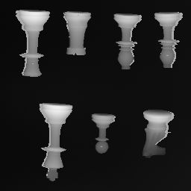
Consider this picture

Slide 3
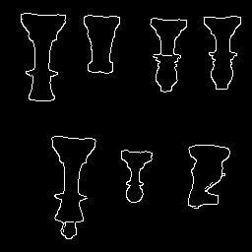
We would like its output to be

Slide 4
Edge Detection
So, to repeat: The purpose of Edge Detection is to find jumps in the brightness function (of an image) and mark them.
Before we get into details, we need to detour
and introduce the concept of Convolution.

Slide 5
Introducing Convolution
Is an operation between two tables of numbers,
usually between an image and weights.
Typically, if one table is smaller, it is on the right of the operator
*
[ ] [ ] = ???
Image Weights
*
-1 +1
-2 +2
0 2
1 3

Slide 6
Executing a Convolution
Pad left array with several zeros.
Do a double-flip or diagonal flip on right array.
Then compute the weighted sum.
(In practice we don’t do double flip.)

Slide 7
Convolution: Step One Padding an array with zeros
[ ]
-1 +1
-2 +2
Do we start Convolution at the start of original numbers or from the padded numbers?
0 0 0 0 0 0
0 0 0 0 0 0
0 0 -1 +1 0 0
0 0 -2 +2 0 0
0 0 0 0 0 0
0 0 0 0 0 0

Slide 8
Convolution : Step Two Double Flip the second array
[ ]
0 2
1 3
[ ]
1 3
0 2
[ ]
3 1
2 0

Slide 9
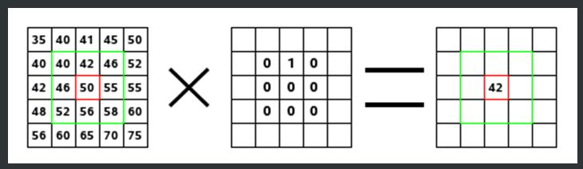

Convolution: Step Three Computing Weighted Sum
The sum of the convolution goes in the upper left hand corner
only for 2x2 tables. Any larger tables should have an odd
number of rows and columns and the sum will go in the center.

Slide 10
Computing Weighted Sum
The computed sum goes in this location, but not on the original image, instead, it goes on an output table.
0 0 0 0 0 0
0 0 0 0 0 0
0 0 -1 +1 0 0
0 0 -2 +2 0 0
0 0 0 0 0 0
0 0 0 0 0 0
[ ]
3*0 + 1*0 + 2*0 + 0*0
This calculates the
weighted sum.
3 1
2 0
The weights
Summing these numbers after weighting them by the individual weights
[ ]
Note: each weighted sum results in
one number.
This number gets placed in the output
array in the position that the inputs came
from.
0

Slide 11
The previous slide….
Was an example of a one-location convolution.
If we move the location of the numbers being summed, we have scanning convolution.
The next slides show the scanning convolution.

Slide 12
Computing Weighted Sum
First compute all columns in first row, then move on to the second row, and so on.
0 0 0 0 0 0
0 0 0 0 0 0
0 0 -1 +1 0 0
0 0 -2 +2 0 0
0 0 0 0 0 0
0 0 0 0 0 0
[ ]
3 1
2 0
3*0 + 1*0 + 2*0 + 0*0
This calculates the
next weighted sum.
The weights
Summing these numbers
This number gets placed in the output
array in the NEXT position.
[ ]
0 0

Slide 13
Computing Weighted Sum
0 0 0 0 0 0
0 0 0 0 0 0
0 0 -1 +1 0 0
0 0 -2 +2 0 0
0 0 0 0 0 0
0 0 0 0 0 0
[ ]
3 1
2 0
3*2 + 1*0 + 2*0 + 0*0
This calculates the
next weighted sum.
The weights
Summing these numbers
This number gets placed in the output
array in the NEXT position.
[ ]
0 0
6

Slide 14
Computing Weighted Sum
In example, have two arrays of four numbers each
One is the image, the other is the weights.
The result is the weighted sums (the output)
[ ] [ ] = [ ]
-1 +1
-2 +2
*
0 2
1 3
0 -2 +2
-1 -6 +7
-2 -4 +6
(image)
(weights)
(weighted sums)

Slide 15
Edge Detection
Now that we have defined convolution, and
know how to execute it, let us put aside the
concept of Convolution, while we consider
a simple approach to detecting a steep jump in
brightness values in a row.
(After that, we will employ the notion of
convolution).

Slide 16
Consider this picture

Slide 17
Consider a row of values in picture
1 2 1 0 98 99 98 97 99 98 1 2 1 2
Look at: abs(jumps in value sideways)

Slide 18
Edge Detection
Create the algorithm in pseudocode:
while row not ended // keep scanning until end of row
select the next A and B pair, which are neighboring pixels.
diff = B – A //formula to show math
if abs(diff) > Threshold //(THR)
mark as edge
Above is a simple solution to detecting the differences in pixel values
that are side by side.

Slide 19
Edge Detection: One-location Convolution
diff = B – A is the same as:
A
B
*
-1
+1
Box 1
Box 2 (“weights”)
Convolution symbol
Place box 2 on top of box 1, multiply.
-1 * A and +1 * B
Result is –A + B which is the same as
B – A

Slide 20
Edge Detection
Create the algorithm in pseudocode:
while row not ended // keep scanning until end of row
select the next A and B pair
diff = //formula to show math
if abs(diff) > Threshold //(THR)
mark as edge
A
B
*
-1
+1
Above is a simple solution to detecting the differences in pixel values
that are side by side.

Slide 21
Edge Detection
Create the algorithm in pseudocode:
while row not ended // keep scanning until end of row
select the next A and B pair
diff = //formula to show math
if abs(diff) > Threshold //(THR)
mark as edge
A
B
*
-1
+1
Note that in this algorithm, we are actually
doing a scanning convolution, the scan
is hidden in the while loop

Slide 22
Edge Detection: Pixel Values Become Gradient Values
2 pixel values are derived from two measurements
Horizontal
Vertical
A
B
*
-1
+1
Note: A,B pixel pair will be moved over
whole image to get different answers at
different positions on the image
A
-1
*
B
+1

Slide 23
The Resulting Vectors
Two values are then considered vectors
The vector is a pair of numbers:
[Horizontal answer, Vertical answer]
This pair of numbers can also be represented by magnitude and direction
Notes:
Maybe students have seen this before in Math class. Geometry or Alg I.

Slide 24
Edge Detection: Vectors
The magnitude of a vector is the square root of the numbers from the convolution
√
The answer to this equation yields the difference of brightness between neighboring pixels. Higher number means a greater sudden change in brightness.
(a)² + (b)²
a is horizontal answer
b is vertical answer
We can plot the output of this equation onto a 2 dimensional image to show edges.

Slide 25
Edge Detection: Deriving Gradient, the Math
The gradient is made up of two quantities:
The derivative of I with respect to x
The derivative of I with respect to y
∂ = derivative symbol
∆ = is defined as
=
I = [ ]
∆
∂ I ∂ I
∂x , ∂ y
|| I ||
So the gradient of I is the magnitude
of the gradient. Arrived at mathematically
by the “simple” Roberts algorithm.
√
The Sobel method takes the average
Of 4 pixels to smooth (applying a
smoothing feature before finding
edges.
(
)
(
)
∂ I 2 ∂ I 2
∂x + ∂ y
Notes:
The previous slide vector is substituted into this derivative formula. For Math majors only.

Slide 26
Showing abs(diff B-A)
Notes:
Add graph showing number absolute value result from B-A. As box moved from a pair of pixels to another

Slide 27
Effect of Thresholding
Any value above threshold means we should mark it as an edge.
Threshold
Bar
Notes:
Add graph showing number absolute value result from B-A. As box moved from a pair of pixels to another

Slide 28
Thresholding the Gradient Magnitude
Whatever the gradient magnitude is, for example, in the previous slide, with two blips, we picked a threshold number to decide if a pixel is to be labeled an edge or not.
The next three slides will shows one example of different thresholding limits.

Slide 29
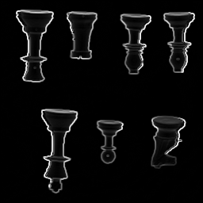
Gradient Magnitude Output
This image takes the original pixels from chess.pgm, and replaces the each pixel’s value using the magnitude formula discussed earlier.
This image does not use any threshold.

Slide 30
Consider this picture

Slide 31
Consider this picture

Slide 32
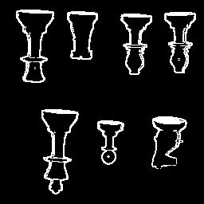
Magnitude Output with a low bar (threshold number)
This image takes the pixel values from the previous image and uses a threshold to decide whether it is an edge and then for edges it replaces the pixel’s value with a 255. If it is not an edge, it replaces the pixel’s value with a 0.

Slide 33
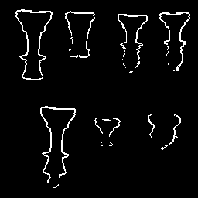
Magnitude Output with a high bar (threshold number)
The higher threshold means that greater changes in brightness must be present to be considered an edge.
Edges have thinned out, but horses head and other parts of the
pawn have disappeared. We can hardly see the edges on the
bottom two pieces.

Slide 34
Magnitude Formula in the c Code
/* Applying the Magnitude formula in the code*/
maxival = 0;
for (i=mr;i<256-mr;i++)
{ for (j=mr;j<256-mr;j++)
{
ival[i][j]=sqrt((double)((outpicx[i][j]*outpicx[i][j]) +
(outpicy[i][j]*outpicy[i][j]));
if (ival[i][j] > maxival)
maxival = ival[i][j];
}
}
Notes:
Make another slide that shows first half of Sobel.c code

Slide 35
Edge Detection
Graph shows one line of pixel values from an image.
Where did this graph come from?
Notes:
Add box with A and B moving from one pair of pixels to another. The data is processed in a sequential manner.
Box moves and it should record

Slide 36
Smoothening before Difference
Smoothening in this case was obtained by averaging two
neighboring pixels.
Notes:
Add box with A and B moving from one pair of pixels to another. The data is processed in a sequential manner.
Box moves and it should record

Slide 37
Edge Detection
Graph shows one line of pixel values from an image.
Where did this graph come from?
Notes:
Add box with A and B moving from one pair of pixels to another. The data is processed in a sequential manner.
Box moves and it should record

Slide 38
Smoothening rationale
Smoothening: We need to smoothen before we apply the derivative convolution.
We mean read an image, smoothen it, and then take it’s gradient.
Then apply the threshold.

Slide 39
The Four Ones
The way we will take an average of four neighboring pixels is to convolve the pixels with
[ ]
¼ ¼
¼ ¼
Convolving with this is equal to a + b + c + d divided by 4.
(Where a,b,c,d are the four neighboring pixels.)

Slide 40
Four Ones, cont.
[ ]
[ ]
¼ ¼
¼ ¼
1 1
1 1
Can also be written as:
1/4
Meaning now, to get the complete answer, we should
compute:
( )
[ ]
[ ]
[ ]
1 1
1 1
-1 +1
-1 +1
Image
*
*
1/4

Slide 41
Four Ones, cont.
( )
[ ]
[ ]
[ ]
1 1
1 1
-1 +1
-1 +1
1/4
Image
*
*
By the associative property of convolution we get this next step.
[ ]
[ ]
( )
[ ]
1 1
1 1
-1 +1
-1 +1
1/4
Image
*
*
We do this to call the convolution code only once, which precomputes
The quantities in the parentheses.

Slide 42
Four Ones, cont.
[ ]
( )
[ ]
[ ]
*
1 1
1 1
-1 +1
-1 +1
1/4
Image
*
We will be getting rid of the 1/4 factor, because it turns out that
when we forget about it, to fix our forgetfulness, we merely need to
raise our threshold by a factor of 4 (which is O.K. because we
were quite arbitrary about how to pick a threshold).

Slide 43
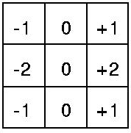
Four Ones, cont.
( )
[ ]
1 1
1 1
[ ]
-1 +1
-1 +1
*
As we did in the convolution slide:
We combine this to get:
This table is a result of doing
a scanning convolution.

Slide 44
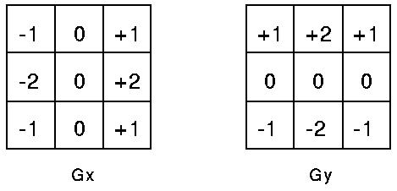

First these two masks are applied to the image.
The magnitude of the gradient is then calculated using the formula which we have seen before:
Then, the two output tables of the masks and image are combined using the magnitude formula. This gives us a smoothened gradient magnitude output.

Slide 45
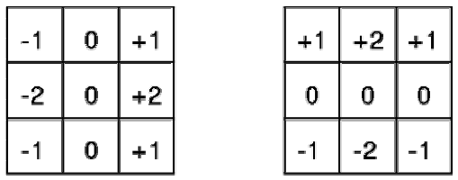
Sobel Algorithm…another way to look at it.
The Sobel algorithm uses a smoothener to lessen the effect of noise present in most images. This combined with the Roberts produces these two – 3X3 convolution masks.
G_{x} Gy

Slide 46

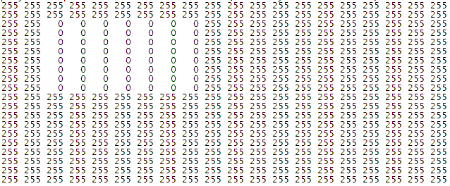
Step 1 – use small image with only black (pixel value = 0) and white (pixel value = 255)
20 X 20 pixel image of black box on square white background
Pixel values for above image
This is the original image. Nothing has been applied to it yet
Notes:
Put this at beginning

Slide 47
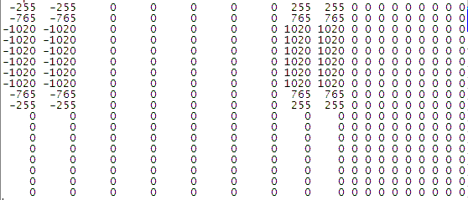
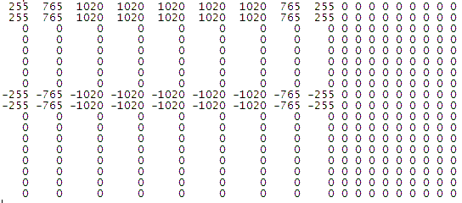
Step 2 – Apply Sobel masks to the image,
first the x and then the y.
X mask values
The masks are then convolved with the x and y masks. These are the results of the convolution
Y mask values

Slide 48
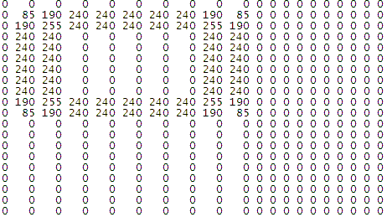
Step 3 – Find the Magnitudes using the formula c = sqrt(X² + Y²)
X mask
^ Using the formula above, the X mask and the Y mask of the image is combined to create the magnitude image below. This is applied to each individual pixel.
Magnitudes
Y mask

Slide 49


Step 4 – Apply threshold, say 150, to the combined image to produce final image.
Before threshold
The left image is the image combined with masks. The right image uses a threshold to separate the grey into either 0 or 255.
After threshold of 150
These are the edges it found

Slide 50
Canny Algorithm
Part One
Convolve with Gaussian instead of four 1’s
Four 1’s is hat or box function, so preserves some kinks due to corners
When convolving, if the picture is the table on the left, then the table
on the right can be viewed as a Filter. i.e., the resulting output is going to
be whatever parts of the picture (table on the left) are to be emphasized.
Thus, table on the right is like a guard, permitting only certain parts of the
input to pass through to the resulting output.

Slide 51
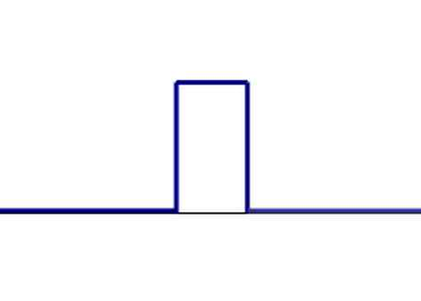
Canny Algorithm
Part One
Four 1’s is hat or box function, so preserves some kinks due to corners

Slide 52
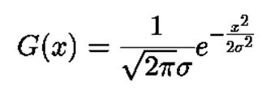
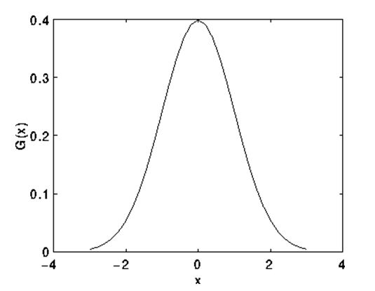
Canny Algorithm, Part One
Gaussian
The bell curve of the Guassian function makes
it ideal to smoothen an image, with out having
kinks in the output.

Slide 53


Canny Algorithm, Part One
Using Gaussian
Instead of convolving with +1|-1 for derivative, take derivative of Gaussian
This is the derivative of a one dimensional function. For an image, we will need to use a two dimensional function.

Slide 54
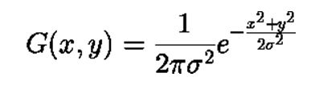
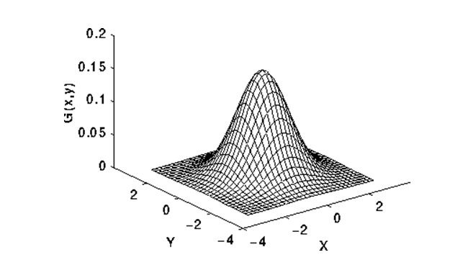
Canny Algorithm, Part One
2-d Gaussian
Take the derivative of this function and use it in our program. Plug in values for x, y, and sigma, to give us a table of weights.

Slide 55
Canny Algorithm, Part One
For derivative, should we convolve Gaussian table with a table of +1/-1’s (as Sobel did) or should we use a formula that has already taken the derivative of the Gaussian? In both cases, we would have to generate a table from a formula. In the first option, the table would be generated from the Gaussian formula, and in the second option, the table would be generated from the (Gaussian’s) derivative equation.
It turns out that the second option is better, if the intent is to increase accuracy.
In either case, we would need to figure out how large our table should be.
We will discuss this size calculation in the context of the first option, but the
reasoning will carry over to the second option as well.

Slide 56
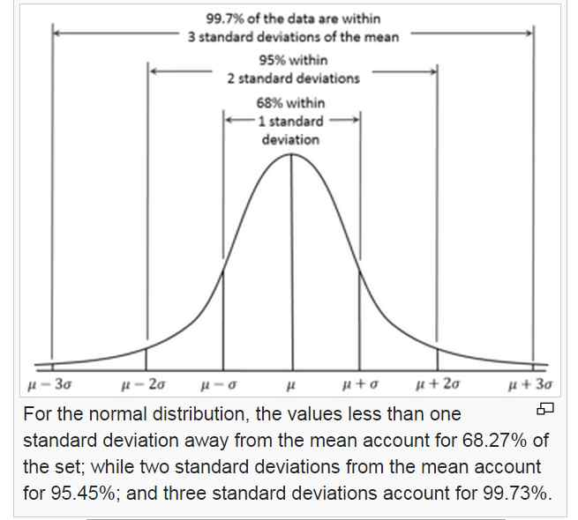
Canny Algorithm, Part One
Using Gaussian, how wide will it be?
We start this size calculation, by noticing this:

Slide 57
Canny Algorithm, Part One
This figure is from Wikipedia
We notice that the Gaussian function has very small values to the left of the
third negative Standard Deviation, and the same behavior to the right of the
third positive Standard Deviation. Hence, we only need to represent the
Gaussian within this window, from negative third SD to positive third SD.
Outside of this window, the values of the function are tiny, and hence
negligible, and so we choose to crop the function at these ends.

Slide 58
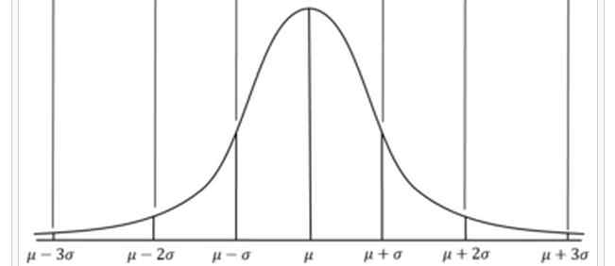
Canny Algorithm, Part One
How wide to represent the Gaussian?
O O O O O O O
So, we will sample our Gaussian at the location of these circles. In general,
Our Gaussian will be represented at one position for the center, and (plus) however
many positions are needed to cover 3σ on each side of the center. A boss will
tell us how large σ needs to be, i.e., how wide the Gaussian is to be.

Slide 59
Canny Algorithm, Part One
Gaussian’s width:
The boss tells us how wide each sigma is to be.
So, if boss says σ is to be 1 pixel wide, then the total window will be
1 + 3*1 + 3*1, i.e., 7 pixels wide.
If boss says σ is to be 2, then window’s total width is
1 + 3*2 + 3*2, i.e., 13 pixels wide.
If σ is to be 3, then total width is 19. And so on. The basic idea is
that the width is give by: 1 + 6*σ.

Slide 60
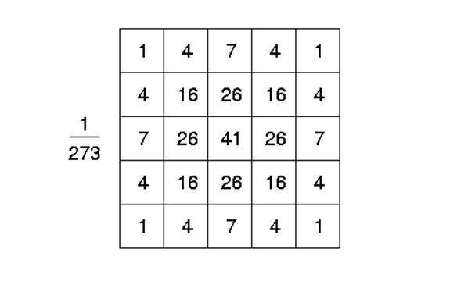
Canny Algorithm, Part One
Using Gaussian
We can use either a table of weights, or we can use an equation within the code to
Increase accuracy.

Slide 61
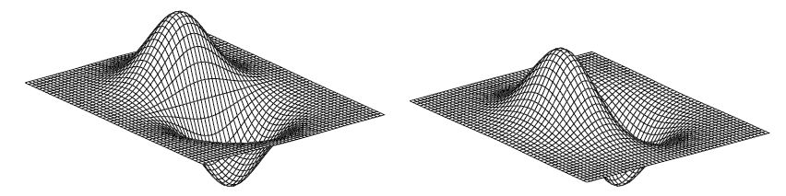
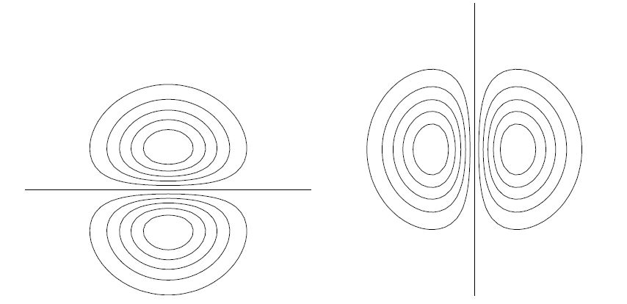
Canny Algorithm, Part One
2-d Gaussian, plus derivative
Instead of convolving with +1|-1 for derivative, take derivative of Gaussian

Slide 62
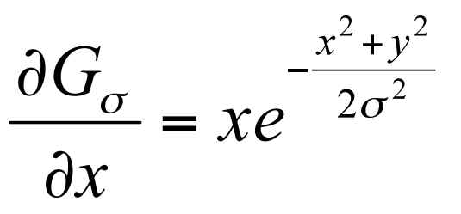
Canny Algorithm, Part One
2-d Gaussian, plus derivative
Instead of convolving with +1|-1 for derivative, take derivative of Gaussian

Slide 63
Canny Algorithm, Part One
So, the main difference between Canny Part One and Sobel is
the smoothener (Canny uses a Gaussian Sobel uses the four one’s.
To write code for canny, we will start with marrh.c and do these steps.
-- Marrh.c uses flexible size masks (which we need), we will keep
this part of the code.
-- Marrh.c uses second derivatives, whereas we need only first derivatives
(we need first x- and y- derivatives), so we will change the equation
in the marrh.c line to be the first x-derivative.
-- Then, because we need two derivatives, we will double up on that line,
i.e., make a copy of it to compute the y-derivative, finally ending
up with two masks (xmask and ymask).

Slide 64
Canny Algorithm, Part One
-- Then use the convolution code from marrh but remember to double up on it, to get two outputs.
-- Then delete the code in marrh that is below the convolution code.
-- Then bring in the sqrt (of squares) code from sobel. This will compute the
magnitude, will scale it for output, and will print it out.
-- At this point, you are done with Canny part One, and your code should
produce output very similar to the Sobel magnitude image.

Slide 65
Canny Algorithm, Part Two
Peak Finding, Non-Maxima Suppression
Consider four directions available in 3x3 neighborhood
Peak finding first determines edge direction, and then tests the pixels that are on the sides (perpendicular) to see if ithe center pixel has the highest value among said neighbors. If it has the highest value then it will be considered a potential edge. So, peaks are potential edges. If a pixel is not a peak, it has no chance of being an edge.

Slide 66
Canny Algorithm, Part Three
Double Threshholding, Hysteresis Thresholding
First, accept all peak pixels where Magnitude exceeds HIGH, then all who are
connected to HIGHs and also exceed a lower LO threshold.
Often times in edge detection, there will be edges that will be very close to the threshold. This causes noise and dotted edges. Using double thresholding, we can eliminate that noise by having two thresholds, a high and a low. An edge must first exceed the higher threshold. Any peak pixel touching a valid edge must have a value less than the low threshold to not be considered an edge. Conversely, any peak pixel must at least exceed the low threshold for a valid edge neighbor to bring the peak into the final edge.

Slide 67
Canny Algorithm, Part Four
Automatically, determine HI and LO.

